Slide 1


Turn video on,
enable mic & say:
“Hi, this is _(name)_,
I ate ___________ for breakfast”
Click when done
Participants
Chat

Slide 2
Logistics
Walk through
A0
Paper Reviews
Course goal
You feel comfortable reading papers + conducting research
Research ~ answering your own questions

Slide 3

Today’s session
Finish previous class
Review classic DBMS components
Notes on w6113.github.io

Slide 4
#ScholarStrike

Slide 5
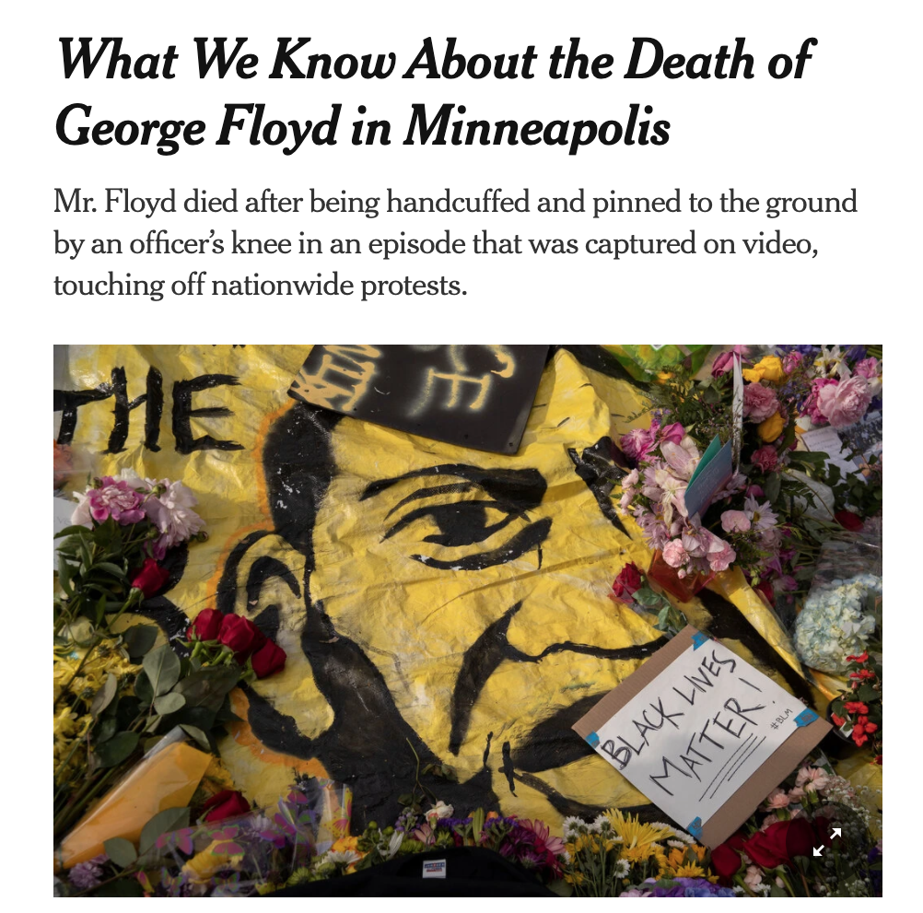
Black Lives Matter

Slide 6

Black Lives Matter

Slide 7
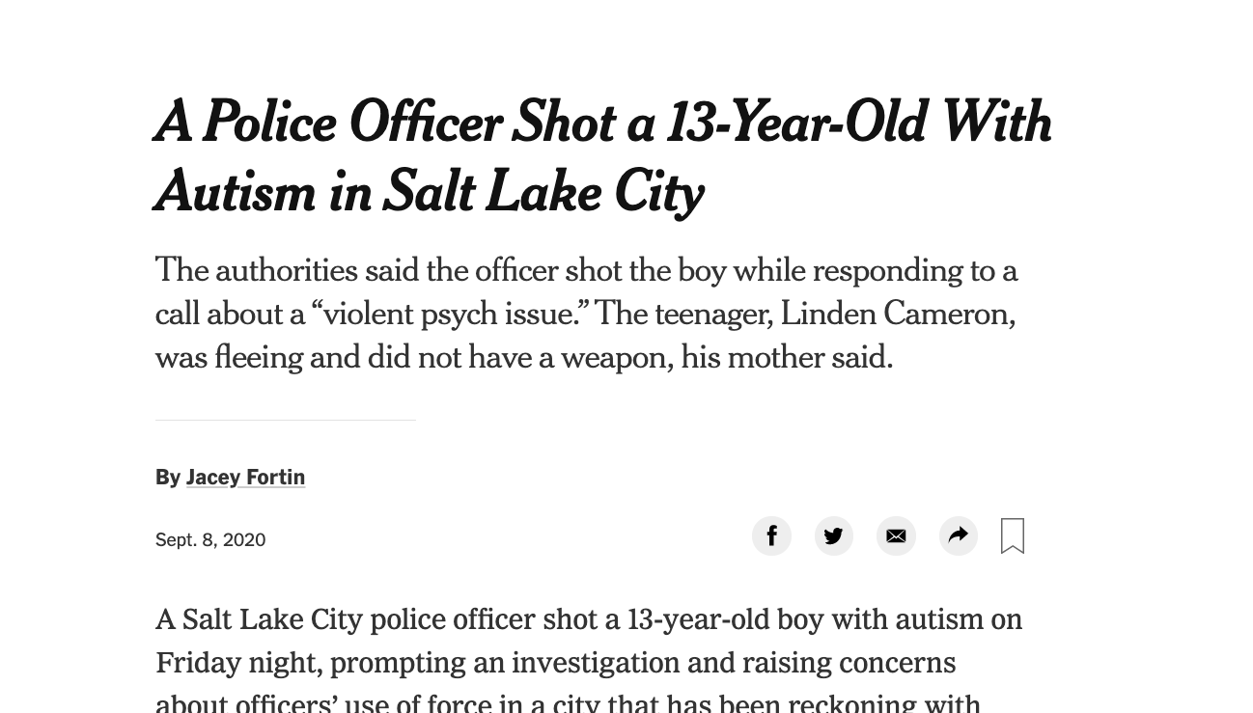
Black Lives Matter

Slide 8

Black Lives Matter

Slide 9


Slide 10
Search terms to learn more
john oliver police
Netflix 13th
The case for reparations
shutdownstem

